Slide 1
The Reticulate Package

Slide 2
What is Reticulate?
Like DBI, which I talked about previously, Reticulate is a package for R-Studio that allows chunks of python code to be ran.
Allows Python packages to be easily used if they are preferable in a given circumstance.
Also allows Python objects to be seamlessly integrated with R code.

Slide 3
Setting Up Python
First we need use the library function to call the reticulate package in the r-setup chunk.
Then we need to define where python is stored on the machine with the use_python function. In most cases "/usr/bin/python3" is an acceptable directory.

Slide 4

Setting Up Python
Code needed to load reticulate and define where Python is stored.

Slide 5
Setting Up Python Packages
If we’d like to use a common Python package like Pandas, Numpy, Matplotlib, etc., we’ll need to install it with the py_install function.
This function is very similar to the install.packages function that is used in R.

Slide 6

Setting Up Python Packages
These three lines installs Pandas, Matplotlib, and Numpy into Rstudio.

Slide 7
Setting Up Python Packages
Once the package has been downloaded, it needs to be “imported” into the R environment.
This is very similar to the library function in R, though it needs to be assigned to a variable name.

Slide 8

Setting Up Python Packages
These pull the desired packages and load them into the environment.

Slide 9
Running Python Code
Running code in a python chunk is just like running R code in a R chunk. Code can be written inside the code chunk in the standard Python Syntax.
Any objects created in a python chunk can be called in an R chunk with py$, and R objects can be called with r. in a Python chunk.
The following is an example of a basic list.

Slide 10
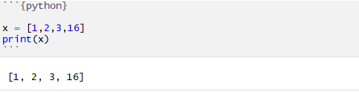
Running Python Code
This defines the list x and prints it out.

Slide 11
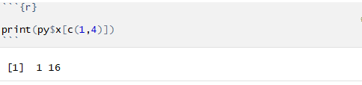
Running Python Code
This takes the same list as before and pulls the first and last element inside an R chunk.

Slide 12
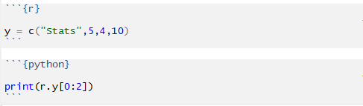
Running Python Code
Takes a vector in an R chunk and prints the first two elements in a Python chunk.
## ['Stats', '5']

Slide 13
Python Dictionaries
A dictionary in python is an associative data structure that allows for the quick searching of records.
We can define and call from these dictionaries using the standard python syntax.
Inside of an R chunk, you can use the $ to call elements in a dictionary.

Slide 14
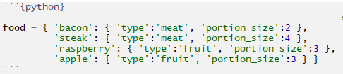
Python Dictionaries
This defines a Python Dictionary.

Slide 15

Python Dictionaries
This prints the type of food that bacon is.
## meat

Slide 16

Python Dictionaries
Also prints the type of food that bacon is, except uses the R code.
## [1] "meat"

Slide 17
Pandas
Pandas is package that brings in data frames and new ways to manipulate them.
These are easily passed to R using the py$ command.
When setting the indexes for Pandas data frames, these become the row names when passed to an R data frame.

Slide 18
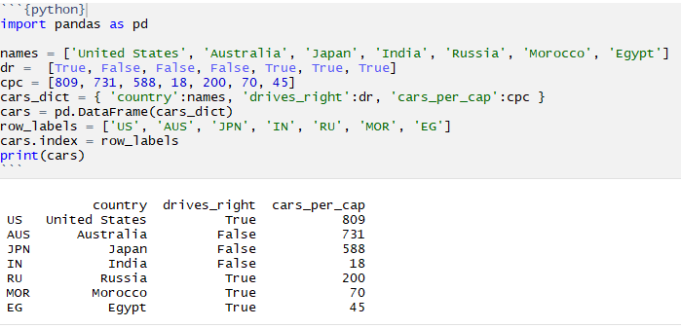
Pandas
This piece of code creates a pandas data frame and prints it out.

Slide 19

Pandas
This takes the same data frame as before, and passes it to and R chunk.
## country drives_right cars_per_cap
## US United States TRUE 809
## AUS Australia FALSE 731
## JPN Japan FALSE 588
## IN India FALSE 18
## RU Russia TRUE 200
## MOR Morocco TRUE 70

Slide 20
Matplotlib
Matplotlib is a Python graphics package that can be used to visualize data.
It is used to make things like histograms, line plots, and scatter plots.
Inside of a Python chunk, the standard syntax is used.
Matplotlib must both be imported in the initial R chunk and defined in the Python chunk.

Slide 21
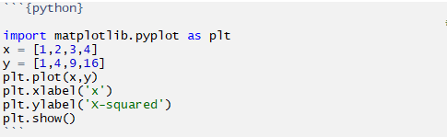
Matplotlib
This code chunk generates a basic plot using Matplotlib

Slide 22
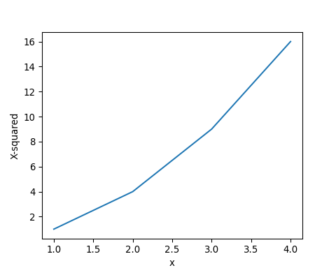
Matplotlib
Basic plot generated into an R markdown file.

Slide 23
Drawbacks to Reticulate
In the R Markdown file, chunks don’t communicate with each other until the code is knit, this makes testing and troubleshooting somewhat difficult.
Some things, like functions and plots, do not pass between R and Python chunks.

Slide 24
Strengths of Reticulate
Opens the opportunity to use powerful Python packages, especially machine learning packages like Scikit Learn that aren’t as readily available in R.
Allows for teams that are familiar in multiple languages to integrate code on a single project.

Slide 25
Thank you

